Slide 1
Structural Response Prediction of a Structural component with Recurrent Neural Networks and temporal convolutional networks
WINTER 2021
ECE271B FINAL PROJECT
TEAM 14: Chin Lee and David Najera

Slide 2

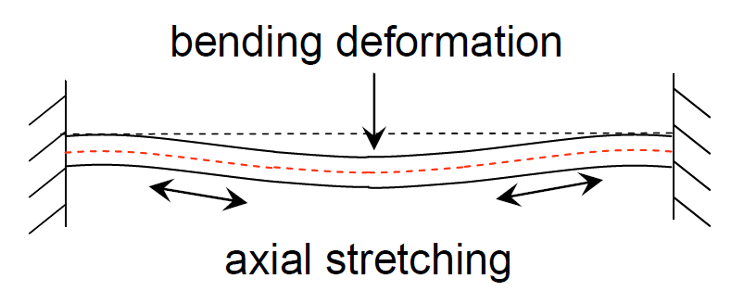
Background and motivation
Challenge: large deformations of structural components introduce nonlinear forces that are hard to compute due to complex physics. Solving for the structural response when nonlinearities are present requires the use of nonlinear solvers, which are computationally expensive. Furthermore, numerical models are not always available and instead, experimental data is all that there is. In that case, a data-driven approach would be preferred.
Solution: employ machine learning algorithms to formulate a data-driven approach to predict the response of a nonlinear structure given a known input excitation.

Slide 3
Methodology and Experiments
We explore the performance of a Long-Short-Term Memory (LSTM) network and a Temporal Convolutional Network (TCN) for time signal forecasting to predict the future structural response given past outputs and current inputs.
We explore the benefits of adding physics-informed regularization terms to the loss functions.
The training data was obtained via numerical simulation. The structural component is a nonlinear flat beam subjected to random vibration excitation.
We compare the performance of the network to an ARMAX model to evaluate the benefits of the nonlinear networks over the linear ARMAX model.
The approach is inspired by autoregressive models, where forecasting is done based on current & past inputs, and past outputs.

Slide 4
LSTM: Challenges and results

Slide 5
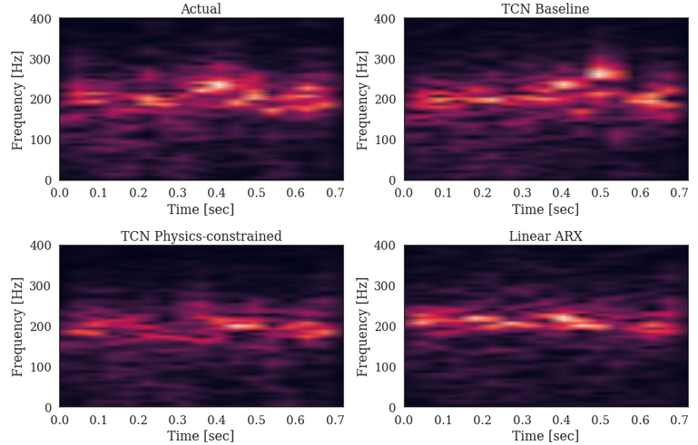
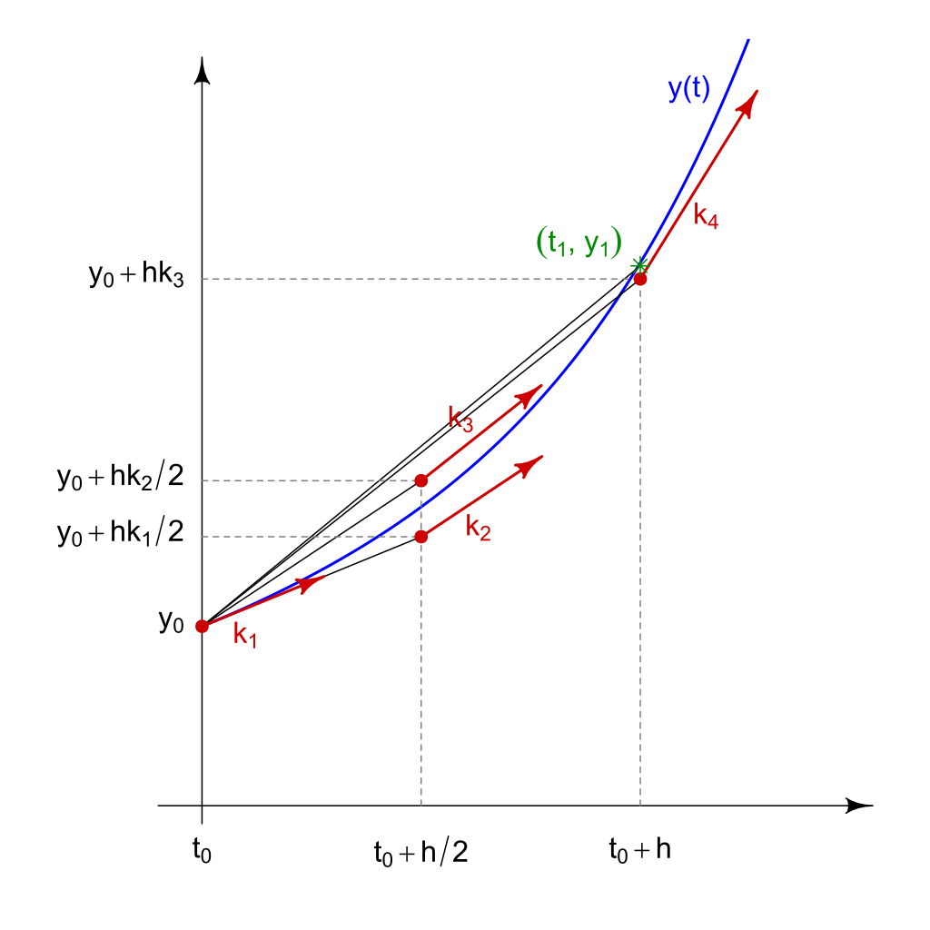
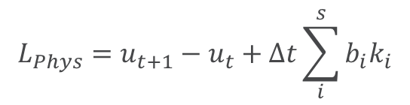
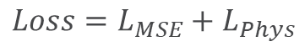
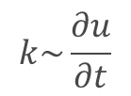
TCN: Challenges and Results
Experiments:
Baseline TCN
Prediction of displacements only
ARX model
Prediction of displacements only
Physics-constrained TCN
Prediction of displacements, velocities, and accelerations
$$Loss=L_{MSE}+L_{Phys}$$
$$L_{Phys}=u_{t+1}−u_{t}+∆t\sum_{i}^{s}{b_{i}k_{i}}$$
$$k\sim \frac{∂u}{∂t}$$
Source: Wikipedia

Slide 6
Summary and Conclusion

